Slide 1

Advanced Clustering & Analysis
Social Media Effects on Mental Health
Vered Shaulov • Elya Davar • Liav Samiya

Slide 2
Part 1: Dataset & Objectives
The foundation of our exploratory data analysis and the core questions driving our models

Slide 3







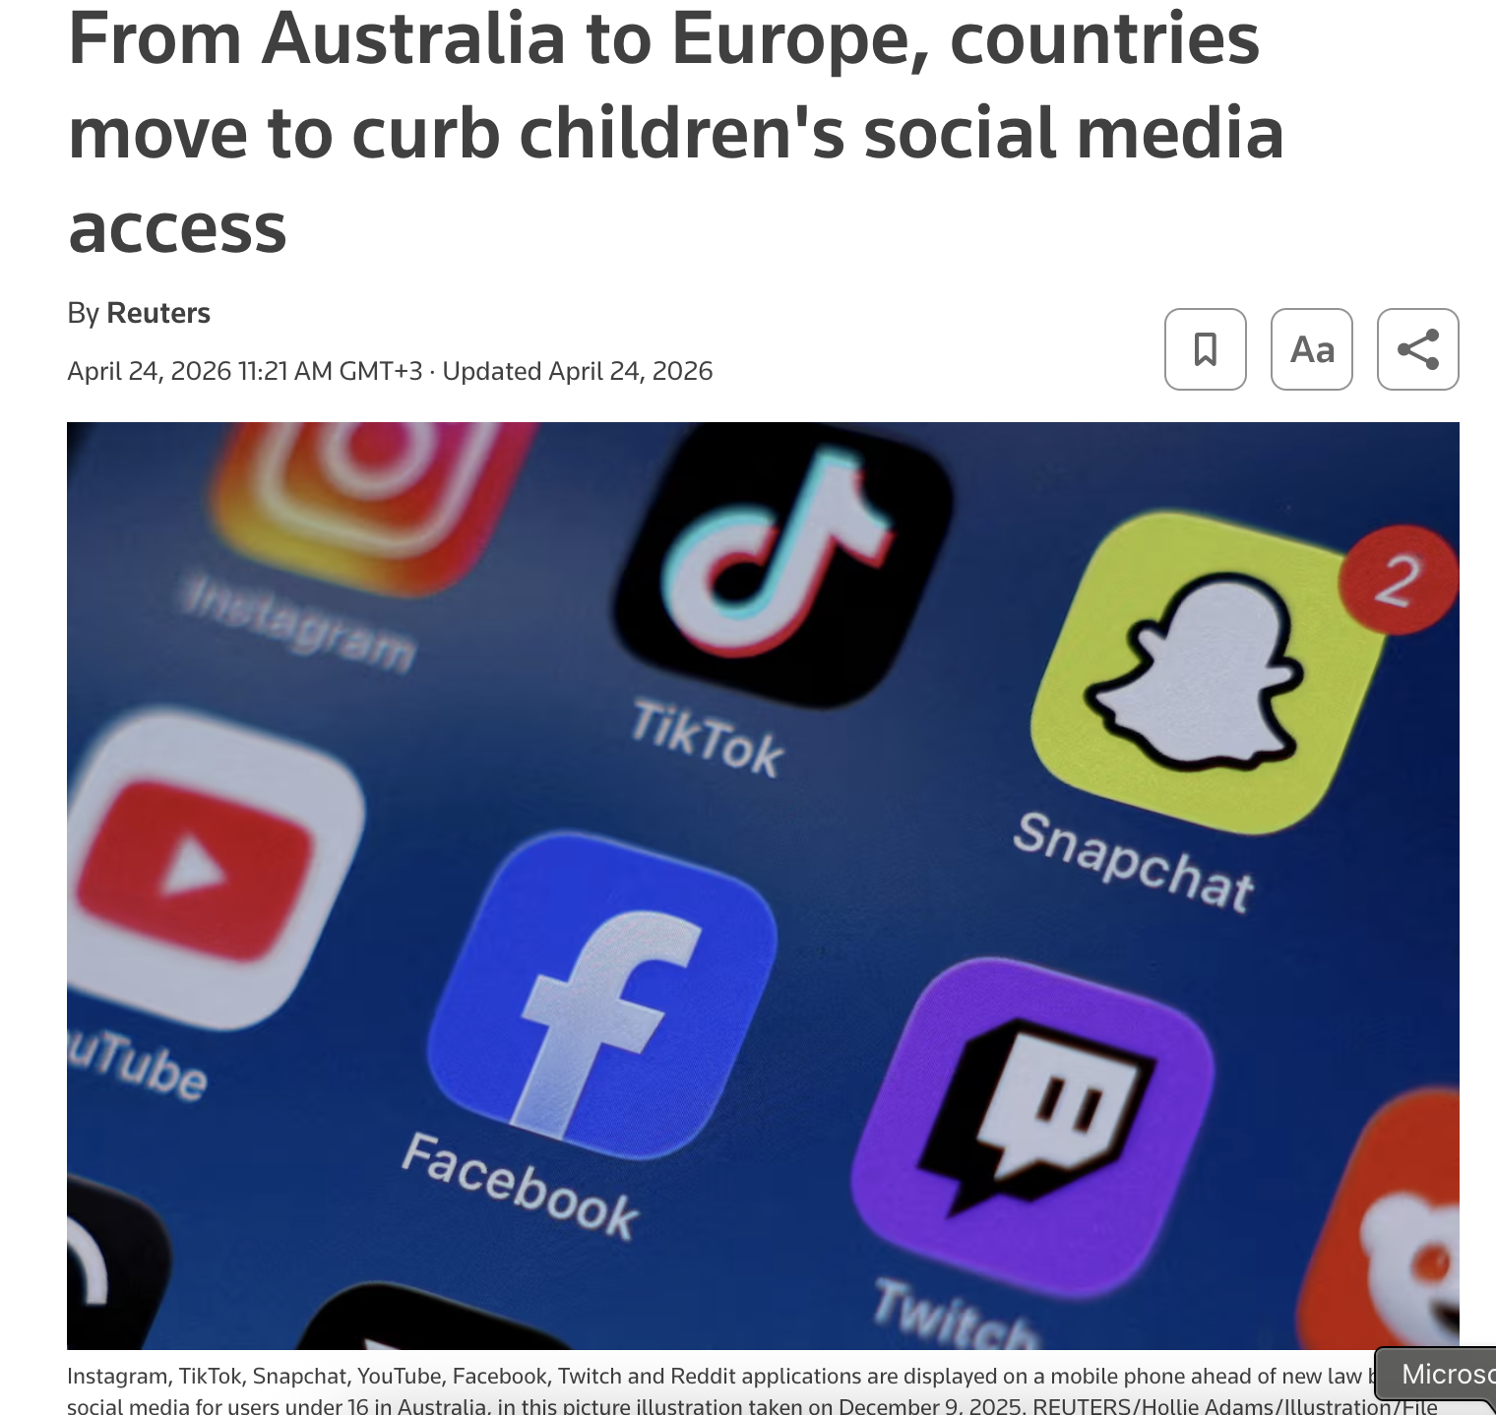
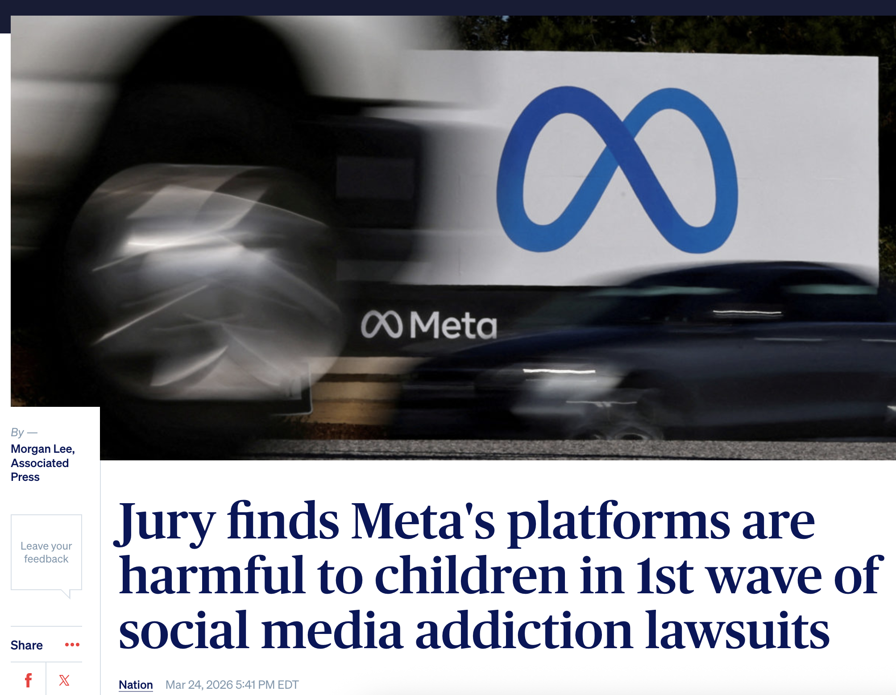
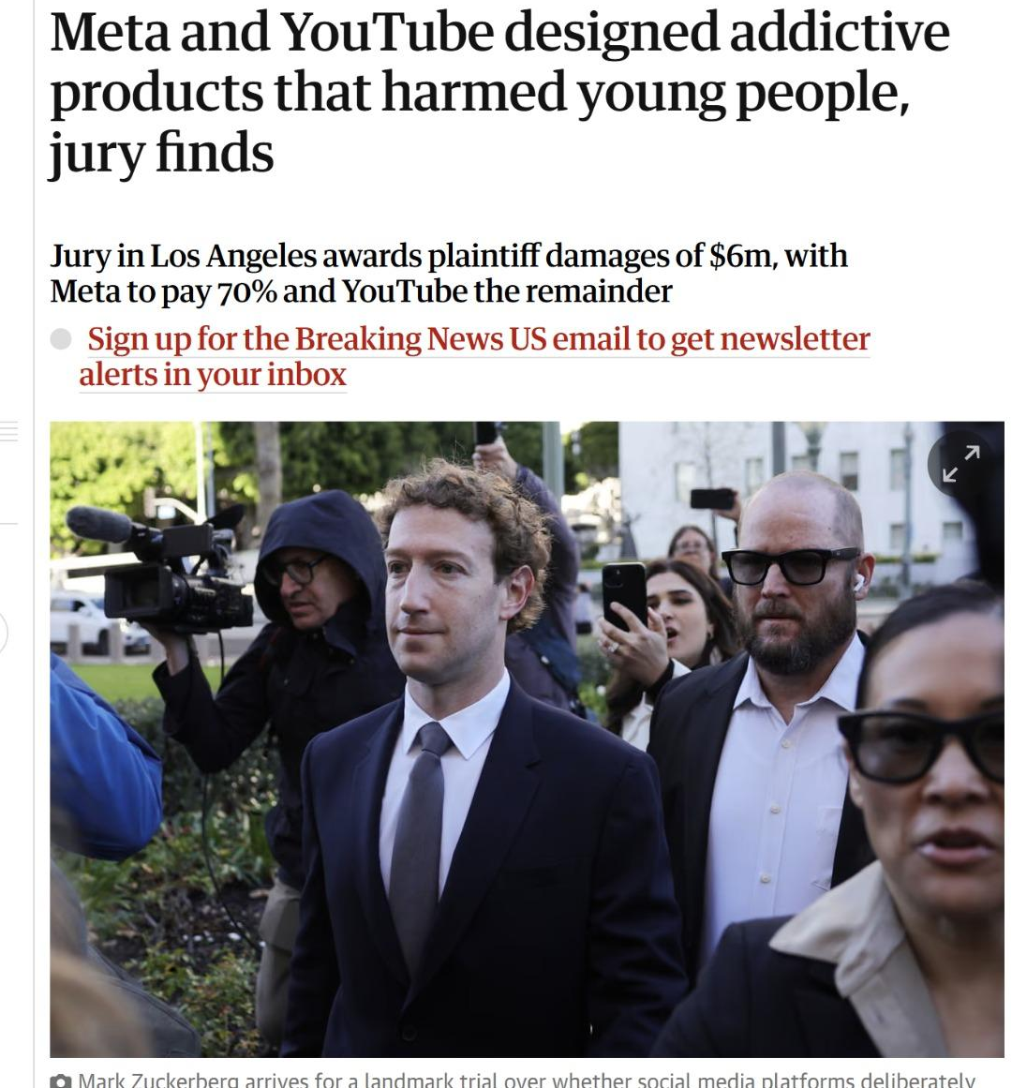

Social Media in the Courtroom

Slide 4
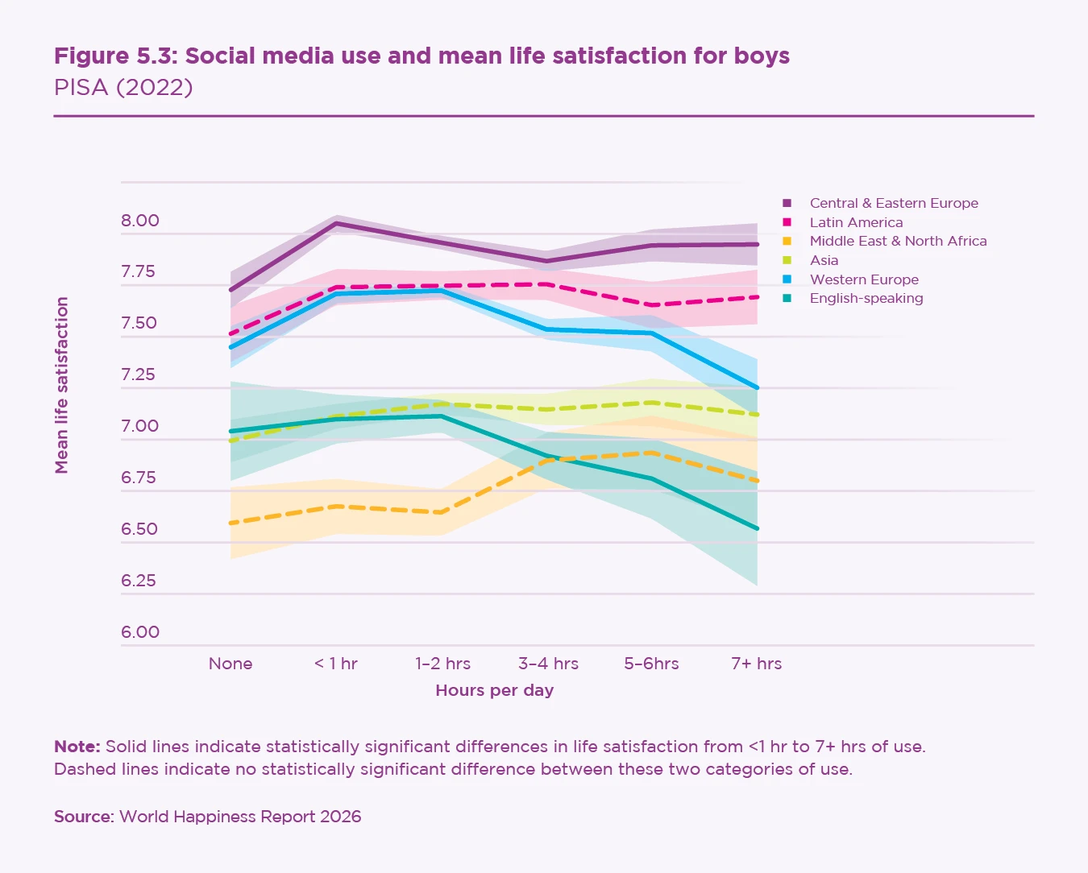
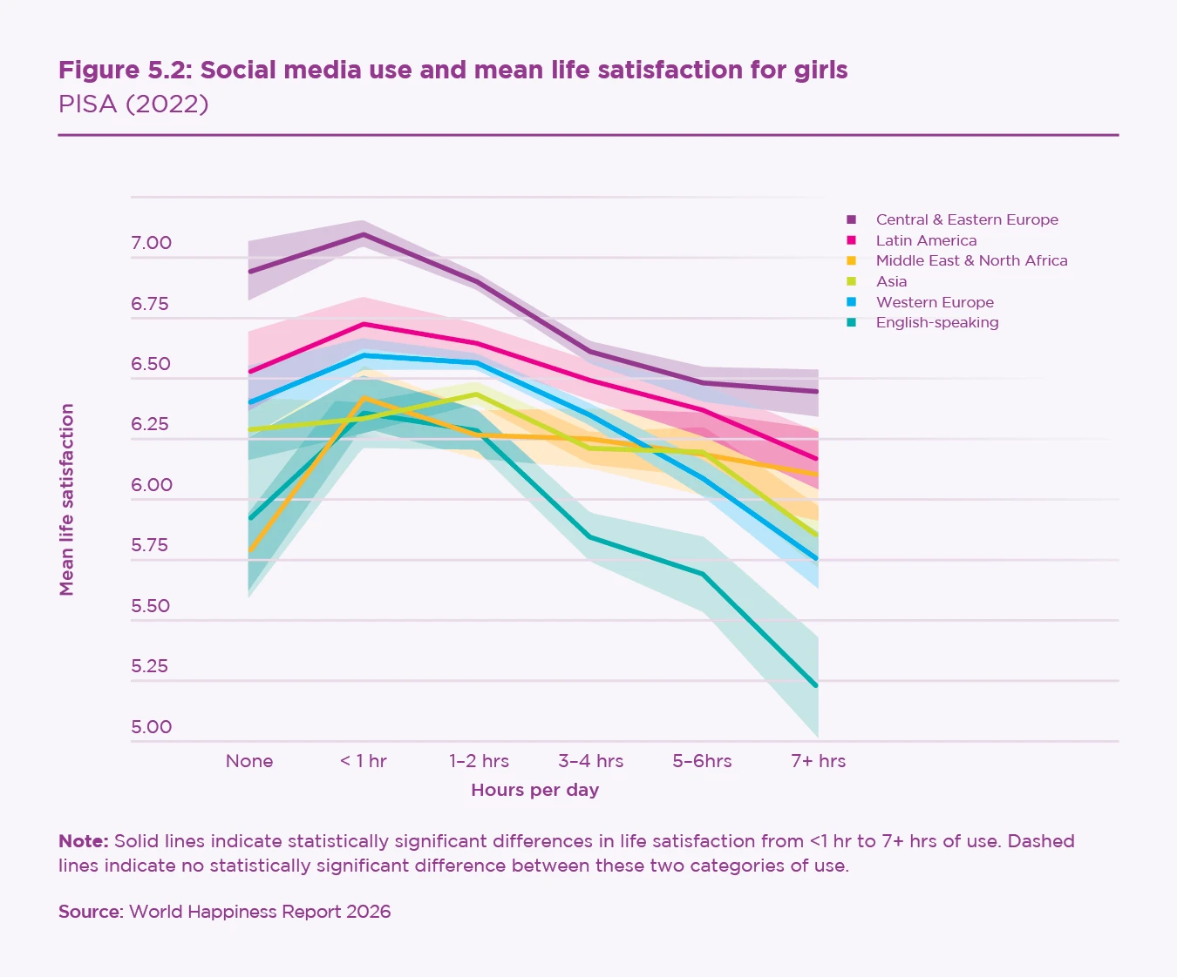
Why This Topic ❓
The World Happiness Report and recent digital well-being studies consistently link rising social media use to declining mental health outcomes especially among younger populations
We chose this topic out of personal connection: as daily social media users, we wanted to investigate whether our own habits carry measurable psychological costs

Slide 5
THE PROJECT QUESTIONS ❓
Does more screen time correlate with high-risk mental states?
Do negative online interactions affect mood and sleep?
Does the choice of the primary social media platform, alongside user age, correlates with user anxiety or stress levels?
How do populations group themselves based on screen engagement and mental state across different ages?

Slide 6
THE DATASET OVERVIEW
5,000
RESPONSES
Questionnaire rows
15
FEATURES
Columns total
3,949
USERS
Clean profiles
2
YEARS
2024 – 2025
7 Platforms Tracked:
Facebook • Instagram • TikTok • WhatsApp • YouTube • Twitter • Snapchat

Slide 7
DATASET STRUCTURE
📁 Originals Columns
📊 Derived Ratios , Metrics & columns added
Age
Platforms
Daily screen time
Social media time
Negatives/Positives interactions
Sleep hours
Physical activity level
Anxiety/Stress/Mood levels
Mental state
ID
Daily screen time without social media
Screen time media ratio
Activity to screen ratio

Slide 8
ANALYSIS PIPELINE & DATA INTEGRITY
❌ Initial Approach (Rejected)
✅ Final Decision (Selected)
Initially considered artificially injecting 5% noise (including missing values, typos, and extreme outliers) to simulate messy real-world environments
Ultimately chose not to corrupt the dataset.
Instead, we maintained the original, clean data to preserve the absolute integrity of the genuine statistical patterns

Slide 9
Data Preprocessing & Engineering
Strategic Encoding
Preventing Bias
Min-Max Scaling
Utilized One-Hot Encoding for nominal features like 'Platform' and 'Gender' to prevent models from inferring false mathematical relationships
Standardized all numerical variables to a uniform 0-1 range so large-magnitude features wouldn't dominate the clustering distance calculations
Applied Ordinal Encoding to 'Mental State' (Healthy=0, Stressed=1, At Risk=2) to preserve its inherent severity hierarchy

Slide 10
Part 2: Theoretical Foundations
Exploring the mechanics of Hierarchical Clustering and Gaussian Mixture Models

Slide 11







Hierarchical Clustering
•
Builds a tree of nested clusters (a dendrogram) by iteratively merging the closest groups based on relative distances.
Potential Pitfalls
Hierarchical algorithms scale poorly on extremely large datasets without subsampling, suffering from significant time and memory complexity:
•
Utilizes an agglomerative approach, meaning it starts with every data point as its own isolated cluster and merges upwards.
Merges are strictly irreversible, meaning early mistakes heavily propagate. Furthermore, it completely lacks built-in handling for noise or extreme outliers.
•
Merges the two nearest clusters at each progressive step until all points belong to one massive, final cluster.
•
Provides a deterministic, hard partition of the dataset without computing probabilistic boundaries.
hyperparameters:
n_clusters
linkage
metric
Notes:
hide

Slide 12




Gaussian Mixture Models (GMM)
Potential Pitfalls
•
Models the data comprehensively as a weighted sum of K independent Gaussian distributions, each possessing its own mean and covariance.
GMM explicitly assumes each cluster is roughly Gaussian, causing it to aggressively struggle with non-Gaussian, irregular shapes (e.g., rigid rings or crescents).
•
Unlike hard-assignment methods, GMM is intrinsically probabilistic: every individual point receives a strict probability of belonging to each specific cluster (soft assignment).
It remains highly sensitive to its initialization and is prone to settling in poor local optima. Components can completely collapse to a singular covariance when features significantly outnumber actual data.
•
Complex parameters are iteratively estimated and refined using the powerful Expectation-Maximization (EM) algorithm.
hyperparameters:
n_components
covariance_type
n_init
Notes:
hide

Slide 13
CLUSTERING ALGORITHMS Recap
Hierarchical Clustering
GMM (Gaussian Mixture Model)
Builds a deterministic tree (dendrogram) by iteratively merging closest groups
➕ Pros: Great for rigid group boundaries
➖ Cons: Scales poorly on large data
A probabilistic approach modeling data as a weighted sum of K Gaussians
➕ Pros: Allows soft assignments
➖ Cons: Sensitive to initialization
Final choice - GMM
Mental health and digital habits do not have rigid boundaries
GMM provides soft assignments (probabilities of belonging), allowing a nuanced profile breakdown

Slide 14
Part 3: Decision & Justification
Comparing PCA and NMF

Slide 15



PCA
NMF
Variance
7 components
3 components
Choosing
K
NMF – PCA
compare
Final
Synthesis

Slide 16
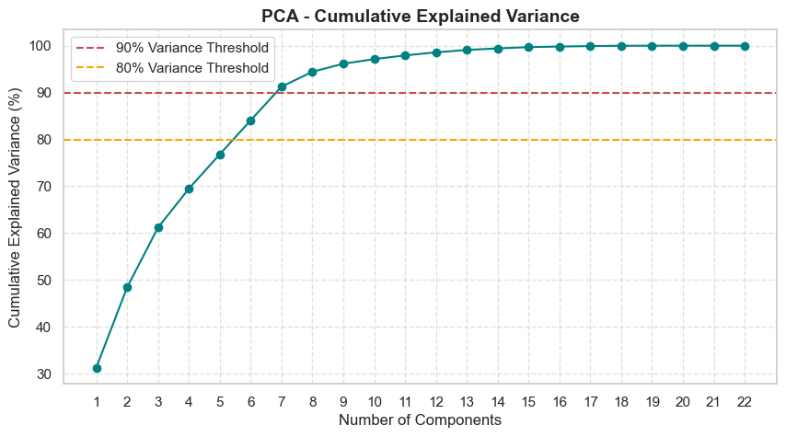
Principal component analysis (PCA)
➕ Advantages:
Highly stable, minimizes reconstruction errors, ideal for denoising
➖ Limitations:
Assumes strictly linear structures, misses non-linear spatial geometry
Applied to compress our 15-dimensional space down to core behavioral axes
Removes redundant noise and avoids the "curse of dimensionality" before clustering
Notes:
add full pca name

Slide 17
Optimal PCA – 7 components
More than 90 percent of the original information is preserved

Slide 18

PCA
NMF
Variance
7 components
3 components
Choosing
K
NMF – PCA
compare
Final
Synthesis

Slide 19
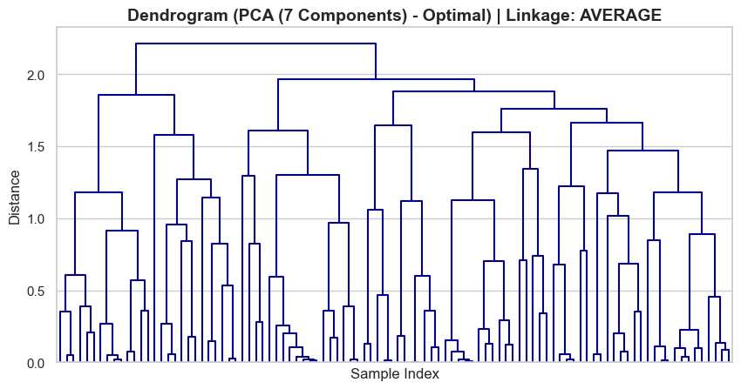
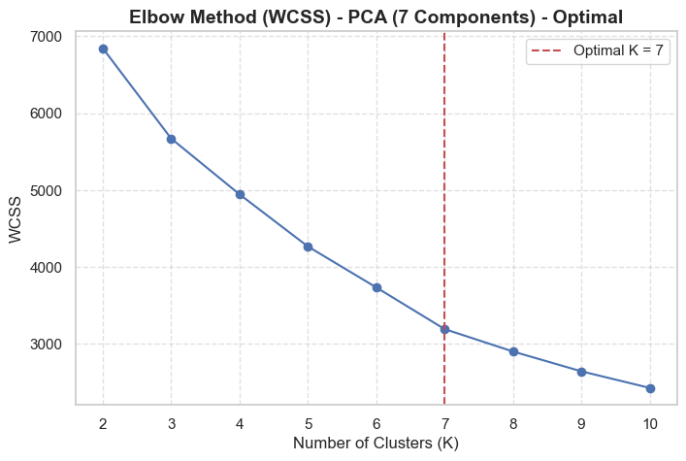
Optimal PCA – 7 components
Choosing number of clusters - k

Slide 20
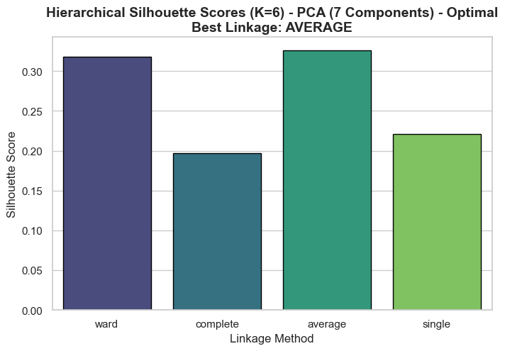
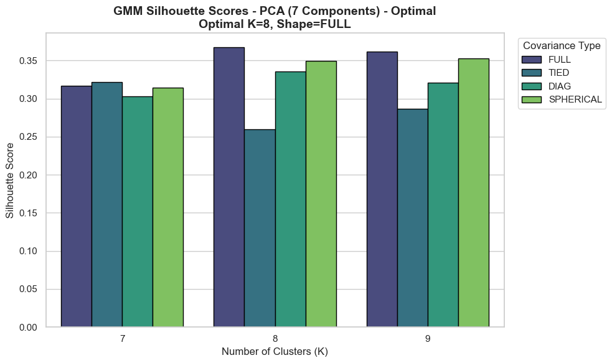
Optimal PCA – 7 components: Choosing clusters
K = 6, Best Linkage: Average
K = 8, Shape: Full

Slide 21
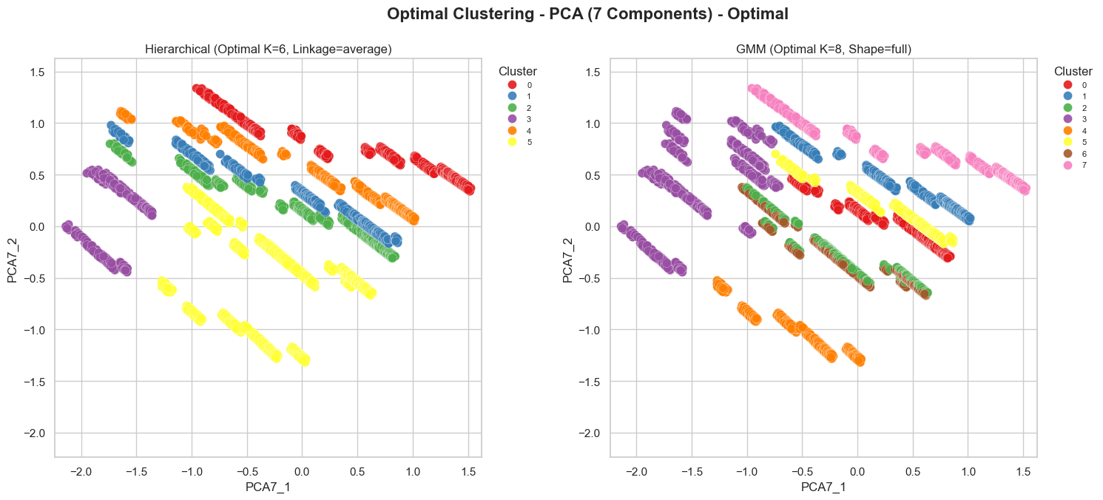
Optimal PCA – 7 components

Slide 22
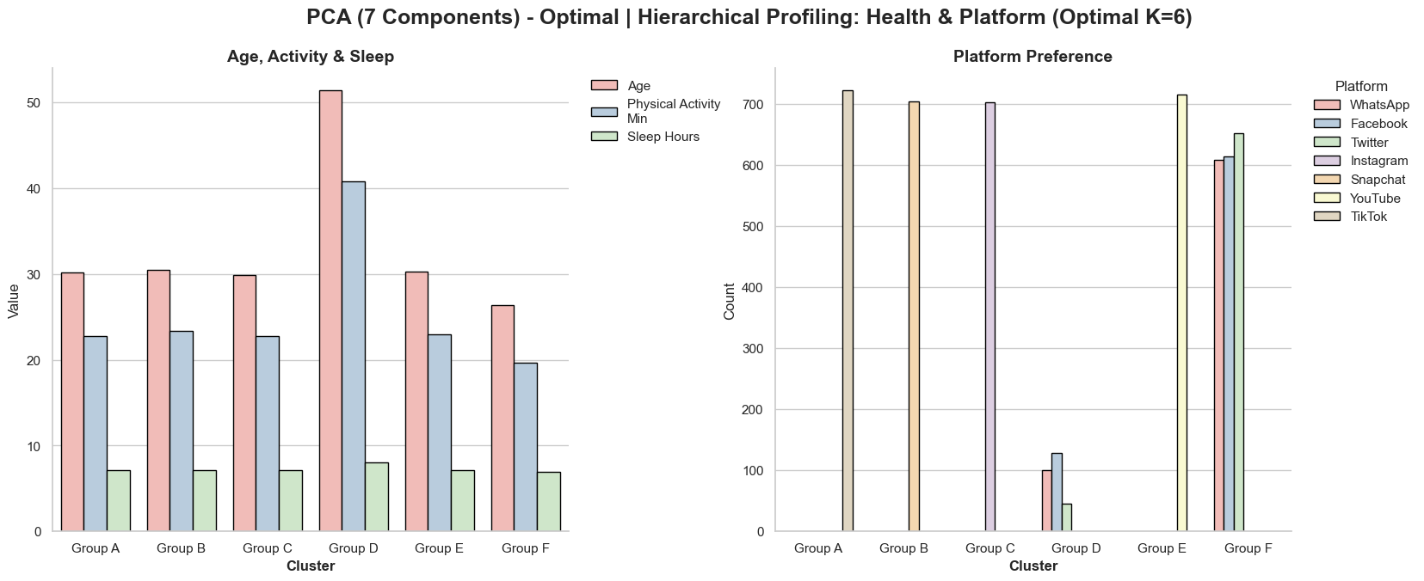
Optimal PCA – 7 components: Hierarchical

Slide 23
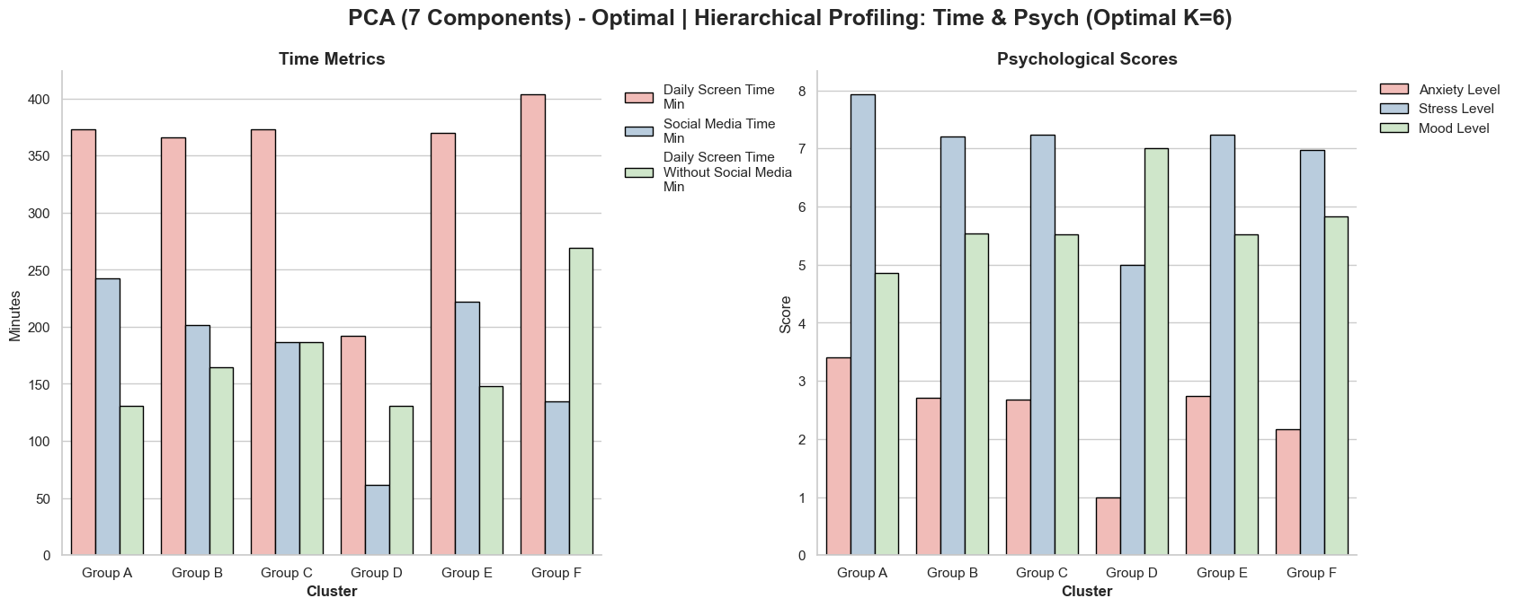
Optimal PCA – 7 components: Hierarchical

Slide 24
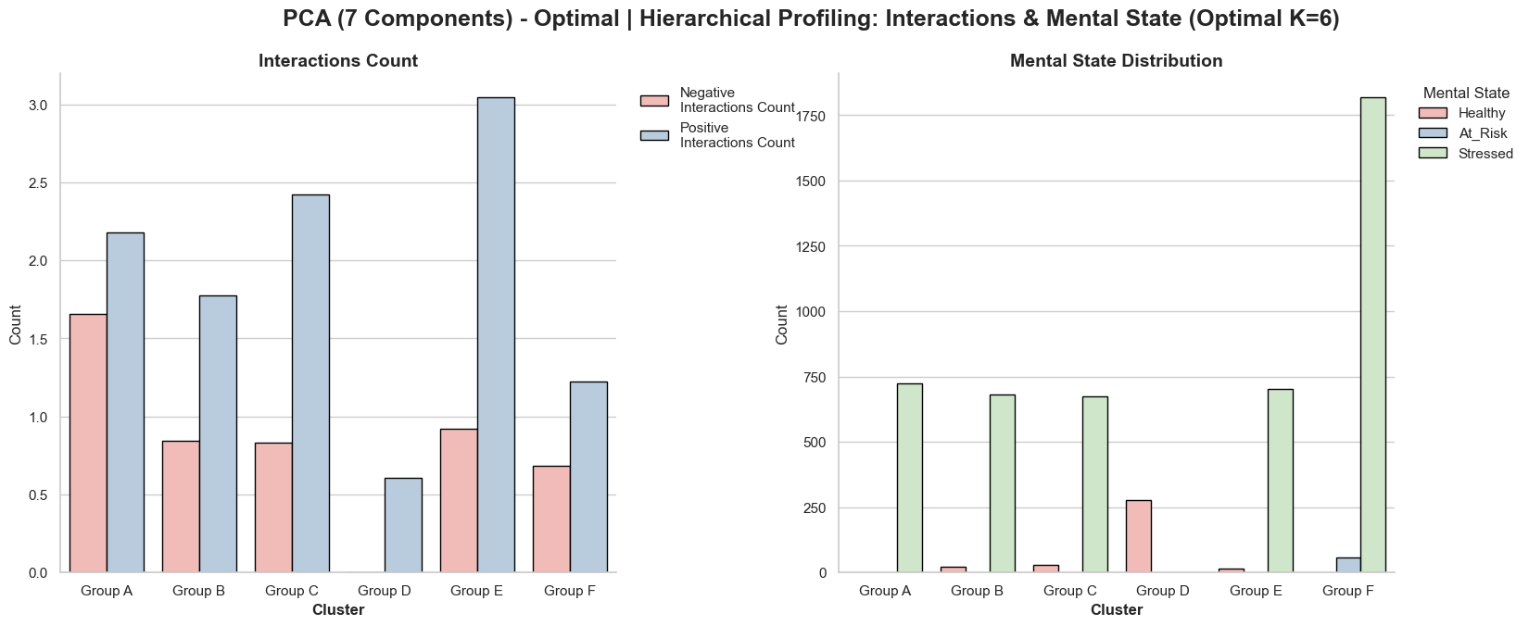
Optimal PCA – 7 components: Hierarchical

Slide 25
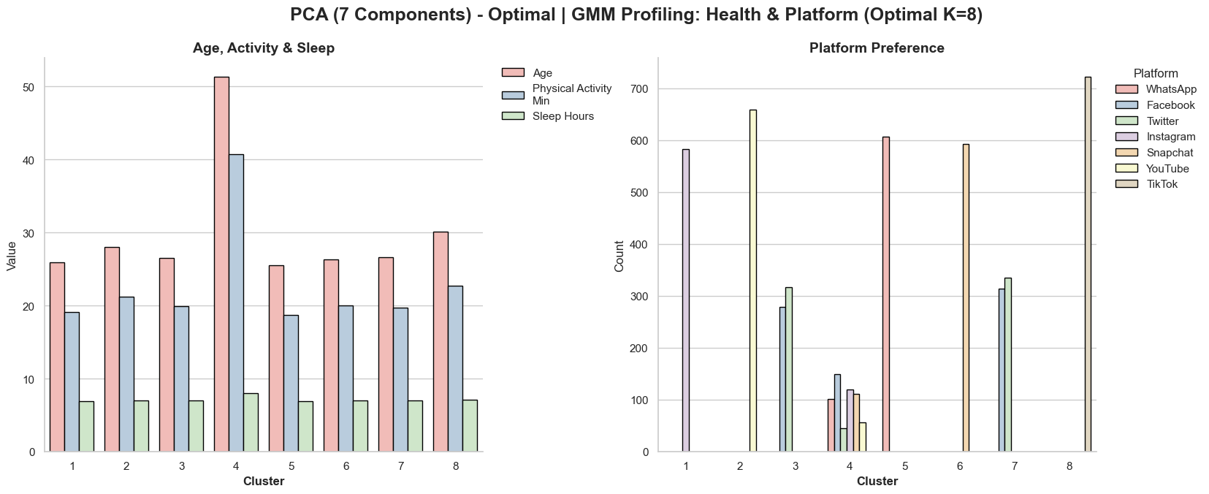
Optimal PCA – 7 components: GMM
Notes:
להסביר את היתרונות של הGMM ולמה שמרנו רק אותו

Slide 26
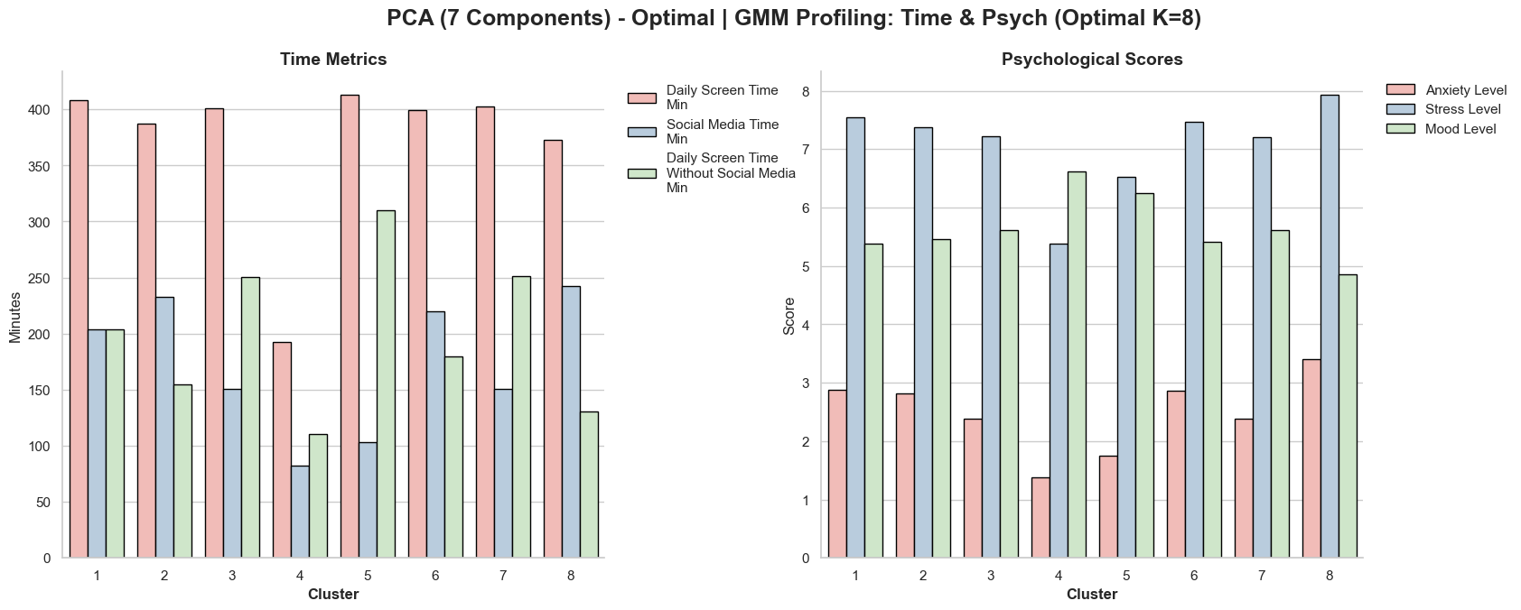
Optimal PCA – 7 components: GMM

Slide 27
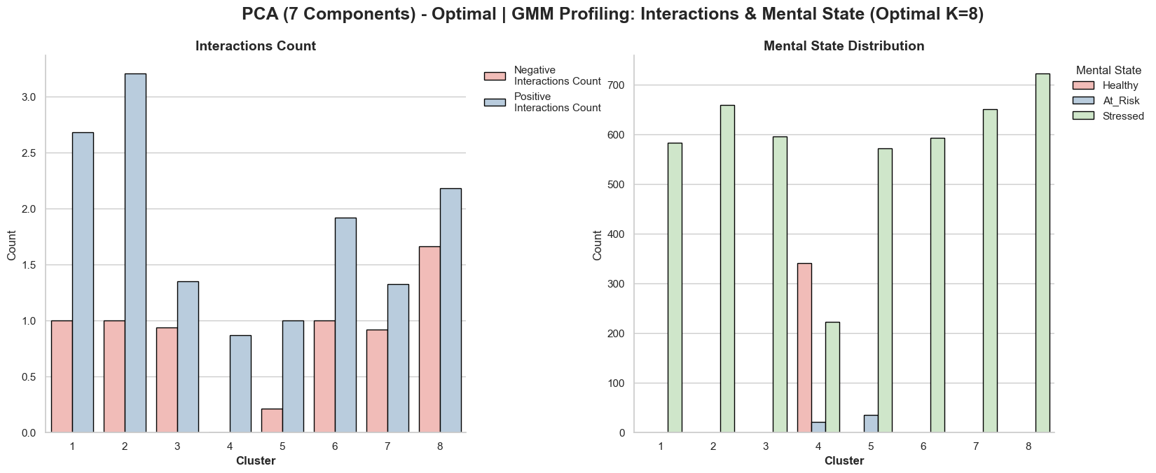
Optimal PCA – 7 components: GMM

Slide 28
PCA
NMF
Variance
7 components
3 components
Choosing
K
NMF – PCA
compare
Final
Synthesis
Since both models produced identical results, we will proceed exclusively with GMM, as its probabilistic boundaries better capture dynamic human behavior

Slide 29
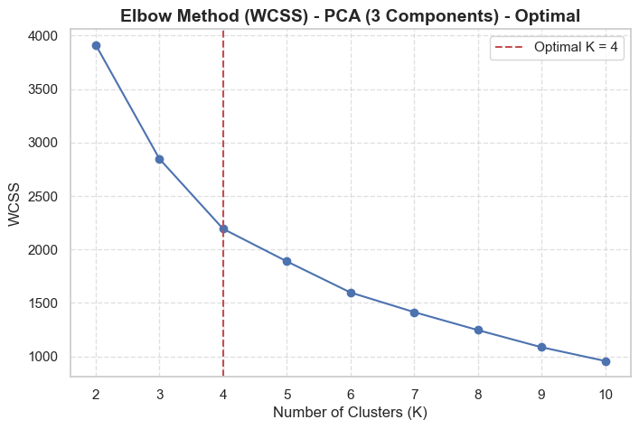
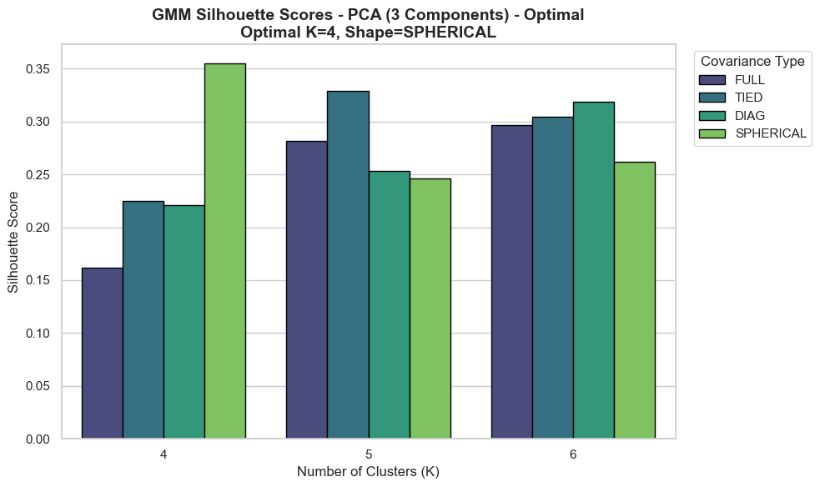
PCA – 3 components:
GMM analyze K = 4
Notes:
add gmm to the title

Slide 30
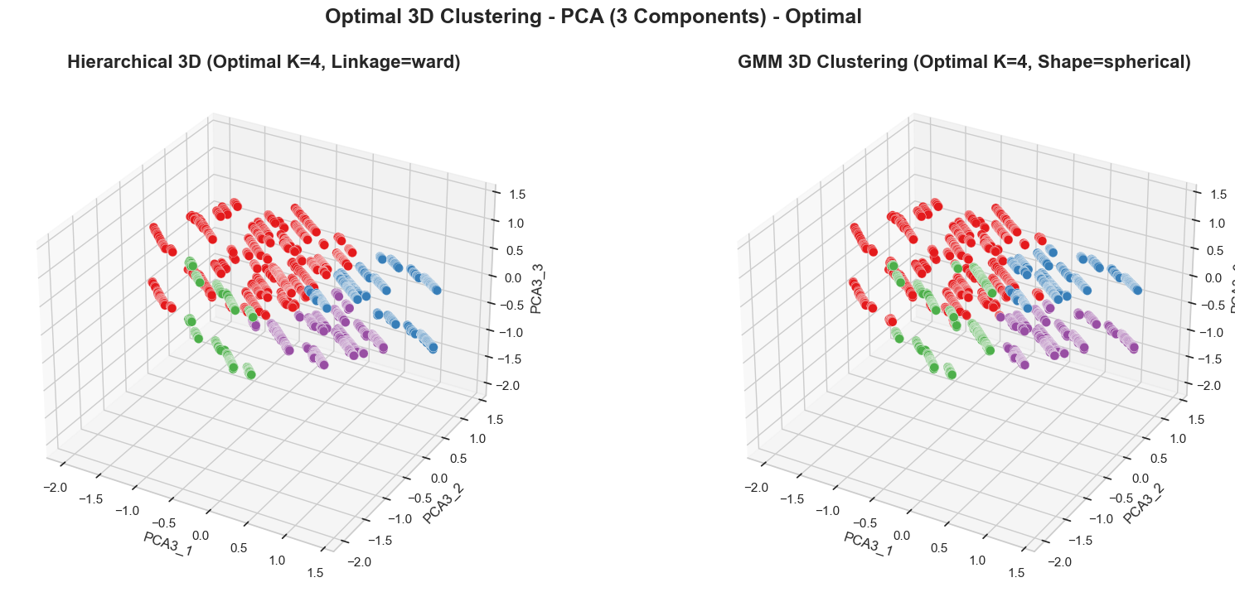
PCA – 3 components:
GMM analyze K = 4
Notes:
add gmm to the title

Slide 31
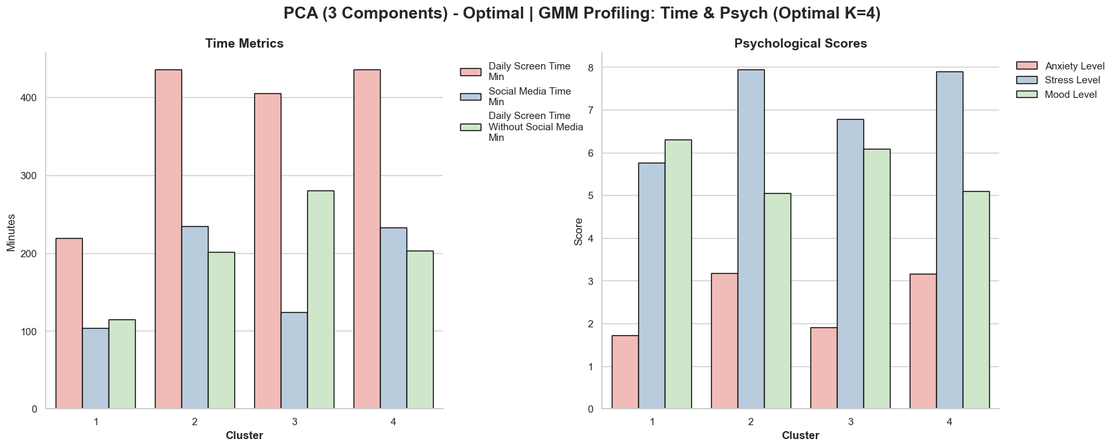
PCA – 3 components:
GMM analyze K = 4

Slide 32
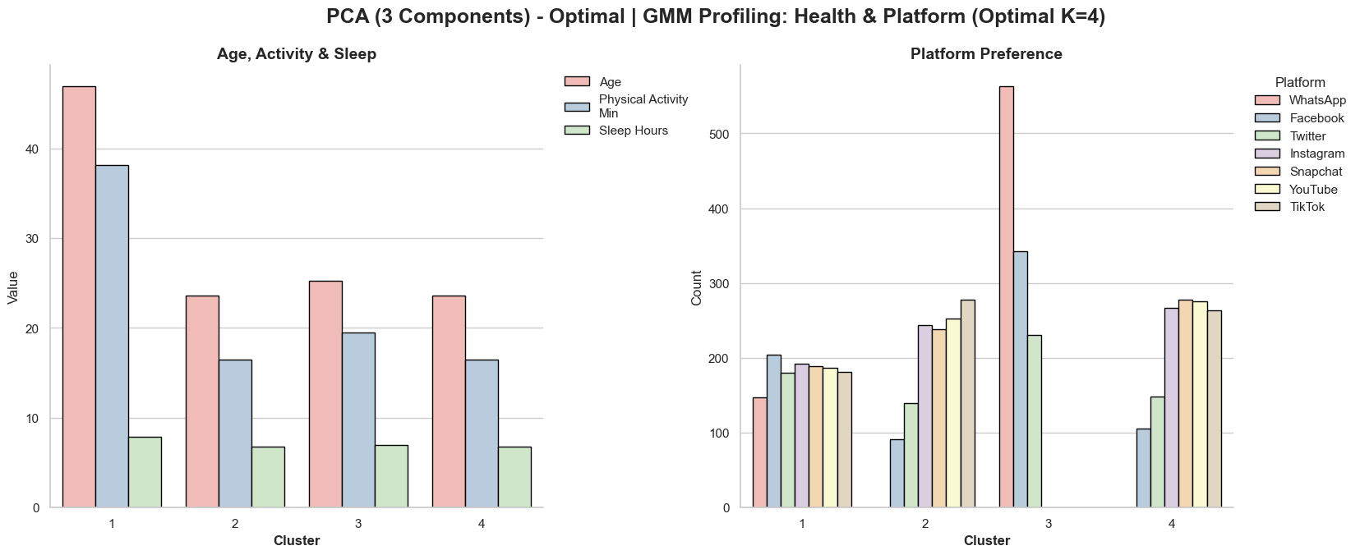
PCA – 3 components:
GMM analyze K = 4

Slide 33
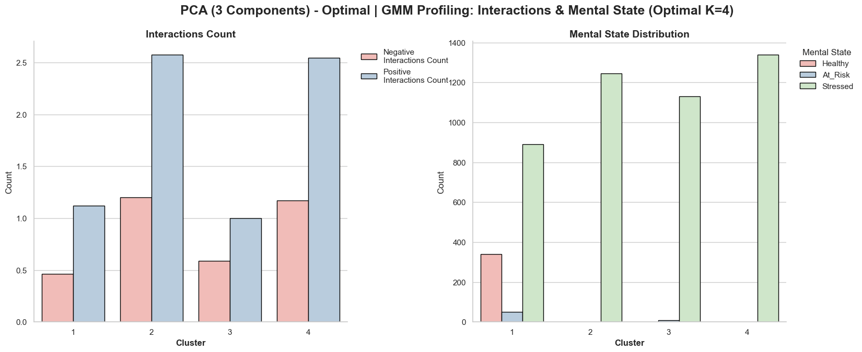
PCA – 3 components:
GMM analyze K = 4

Slide 34
PCA – Quality over Quantity
Visual Limitations
Categorical Overfitting
Behavioral Focus
PCA of 3 Components creates a strict mathematical bottleneck, filtering out artificial noise to reveal the true underlying patterns of digital habits and mental strain
PCA of 7 Components overfits to one-hot encoded features, trivially clustering users by "Platform" rather than actual behavior
PCA of 7 Components prevents clear 3D visualization and intuitive cluster validation

Slide 35

PCA
NMF
Variance
7 components
3 components
Choosing
K
NMF – PCA
compare
Final
Synthesis

Slide 36
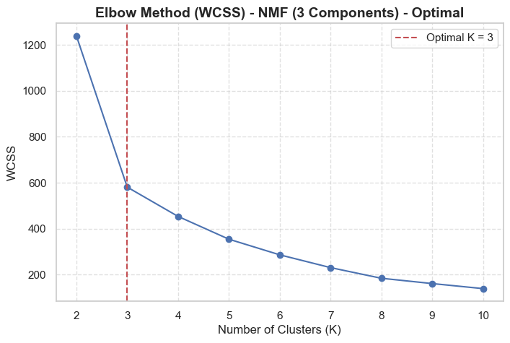
NMF
➕ Advantages:
Purely additive parts learning offers superb physical and logical interpretability
➖ Limitations:
Requires non-negative metrics, prone to non-convex local optimization traps
NMF algorithm naturally optimized at K=3
To ensure a fair, direct comparison between the two dimensionality reduction techniques, we decided to force the PCA model into K=3
This decision is strongly supported by the PCA Elbow plot, where K=3 also presents a distinct and viable bend in the curve
Notes:
we chose k=3 because it’s the breaking point

Slide 37

PCA
NMF
Variance
7 components
3 components
Choosing
K
NMF – PCA
compare
Final
Synthesis

Slide 38
t-SNE
Non-linear mapping technique converting multidimensional distances into probabilistic neighborhood matching
➕ Advantages:
Outstanding at preserving local clusters and highlighting clear boundaries
➖ Limitations:
Distorts global space parameters, cannot pre-process data for clustering rules.

Slide 39
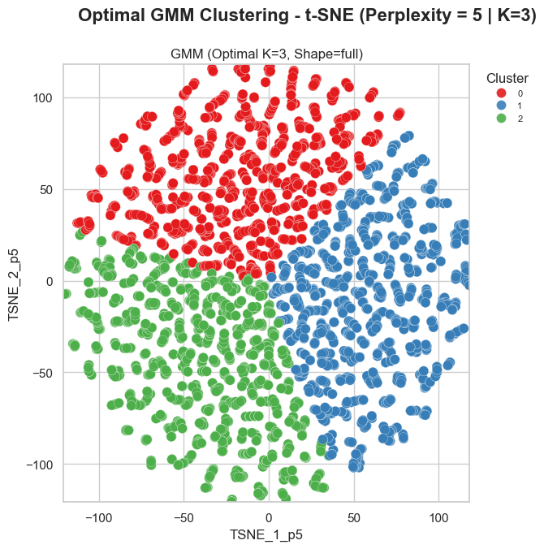
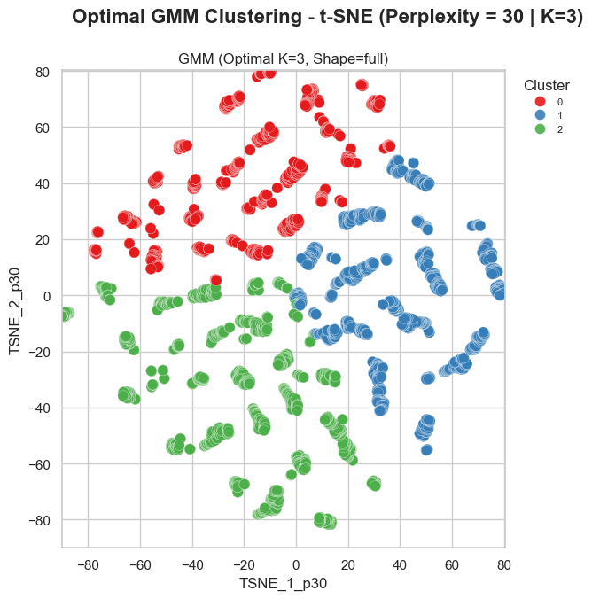
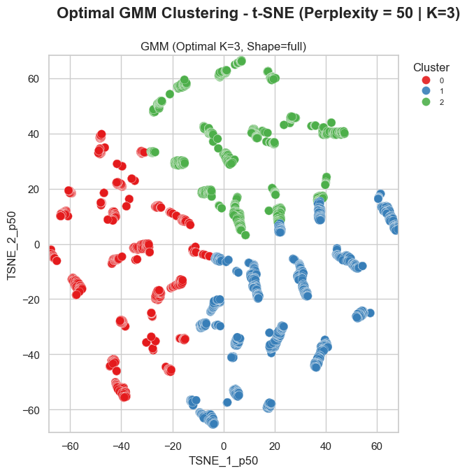
t-SNE – K = 3 Perplexity
We evaluated Perplexity values of 5, 30, and 50 to thoroughly examine both local and global data structures
perfect balance, providing the clearest separation and revealing the most cohesive behavioral clusters
overly compressed the data, causing distinct clusters to overlap and lose their clear boundaries
fragmented the data into artificial "islands"

Slide 40
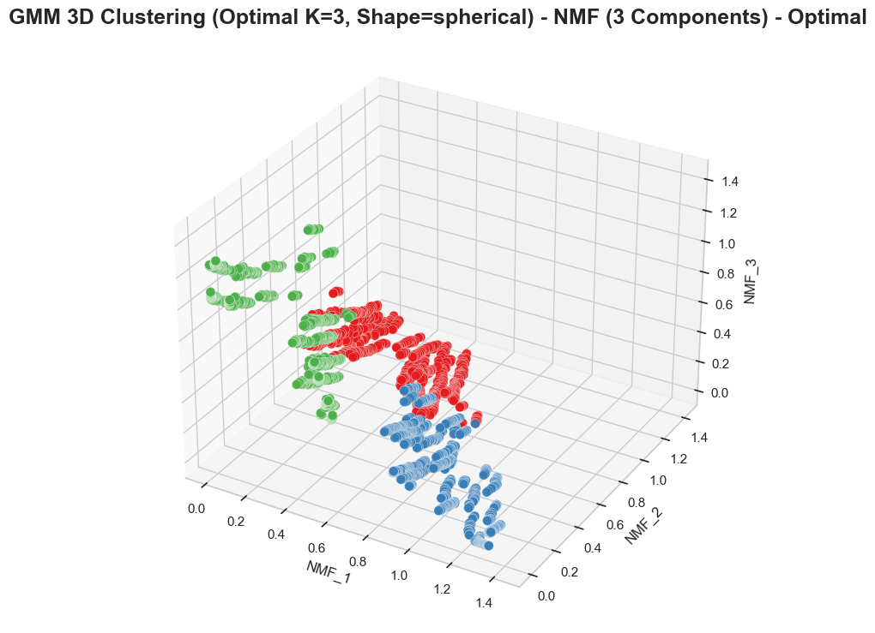
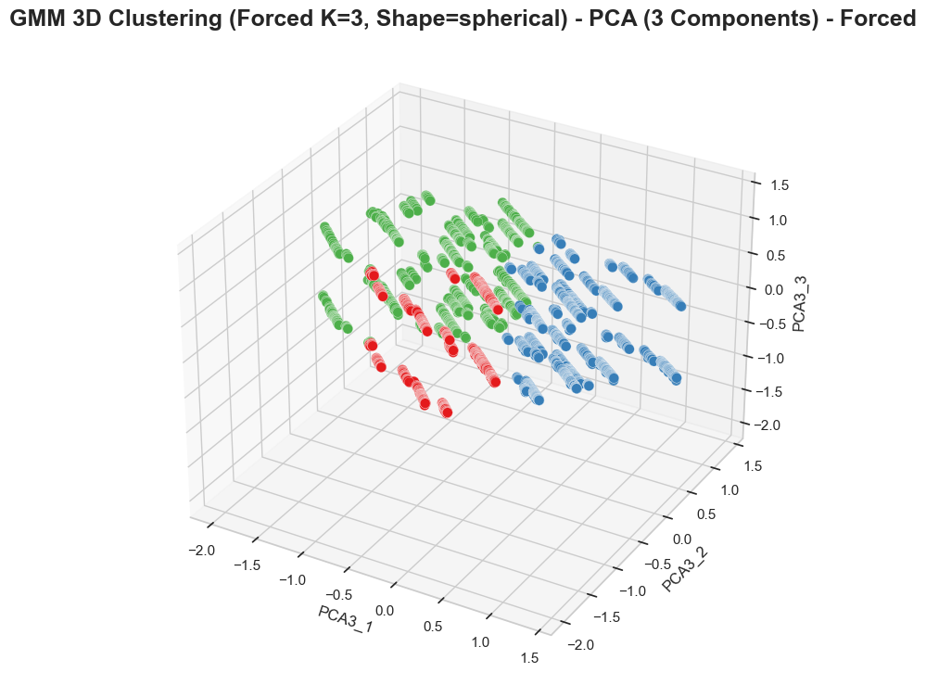
Comparison – PCA and NMF
GMM analyze K = 3
NMF
PCA
Notes:
add a work timeline
לא להגיד שהתוצאות יותר טובות אבל יותר שקל לנו לראות את התוצאות בNMF

Slide 41
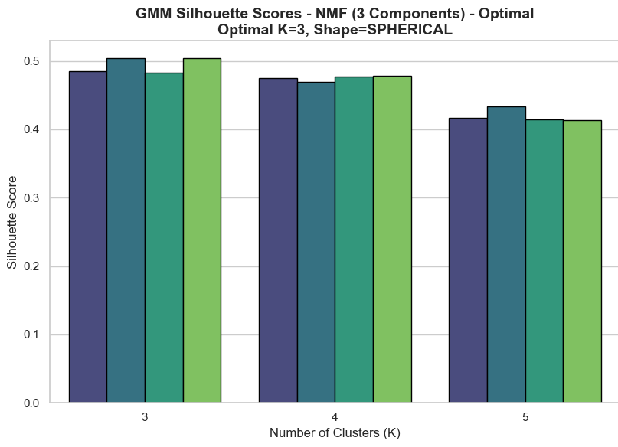
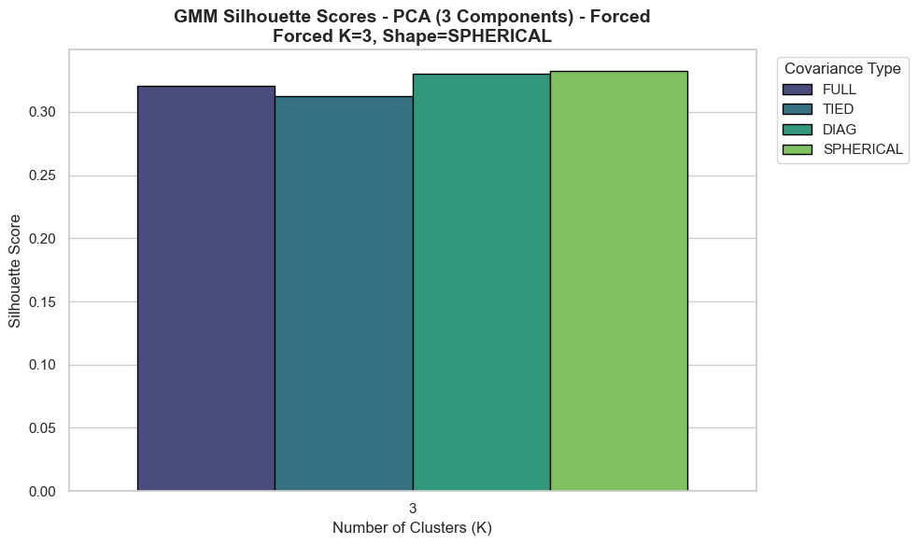
Comparison – PCA and NMF
GMM analyze K = 3
NMF
PCA

Slide 42
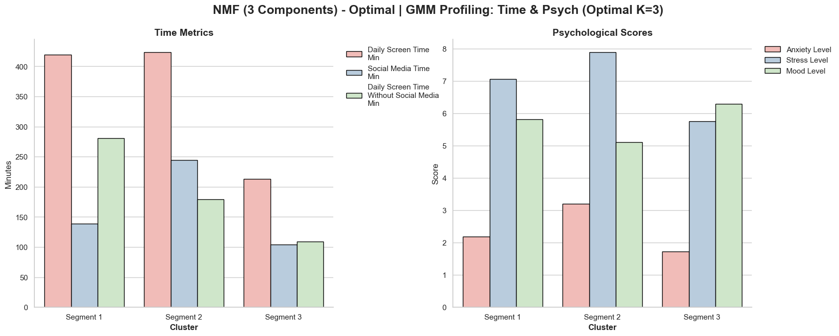
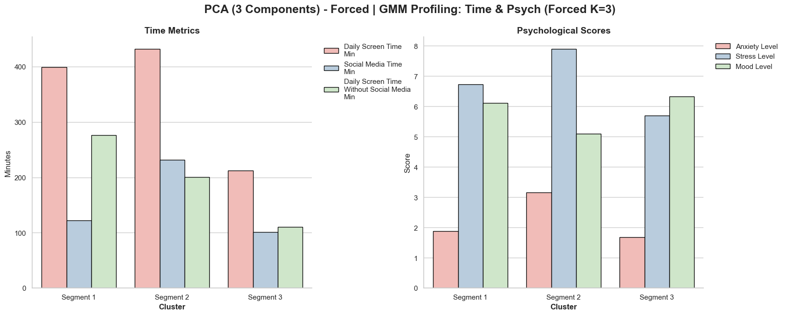
Comparison – PCA and NMF
GMM analyze K = 3
NMF
PCA

Slide 43
Comparison – PCA and NMF
GMM analyze K = 3
NMF
PCA

Slide 44
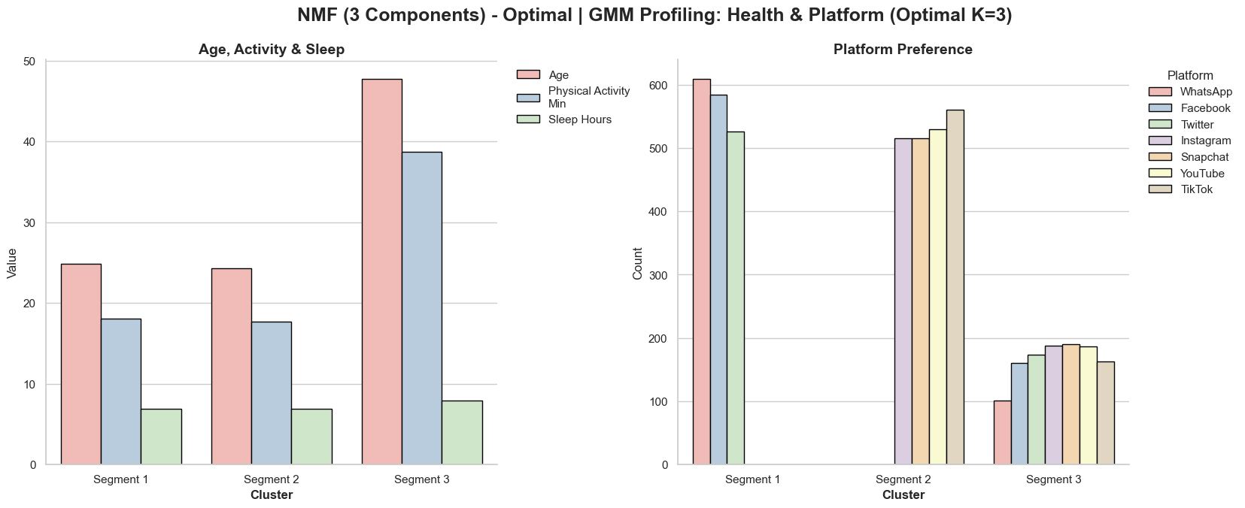
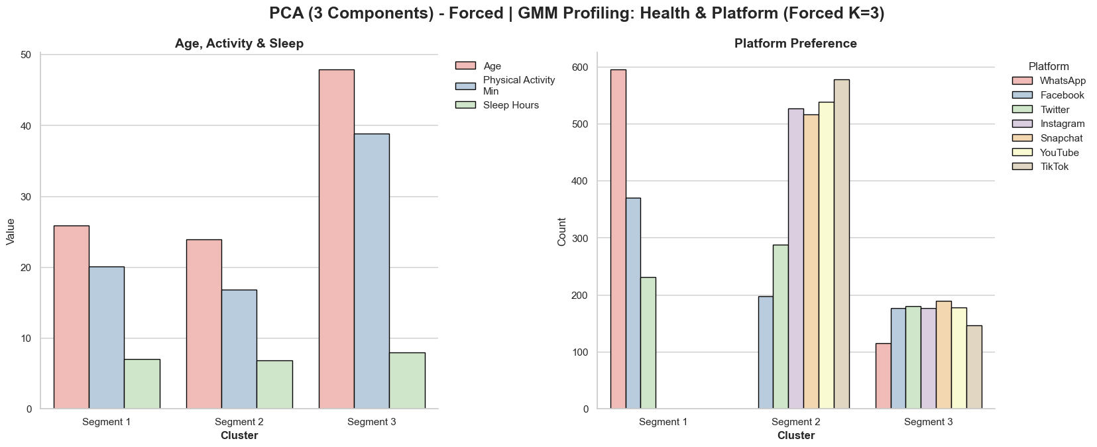
Comparison – PCA and NMF
GMM analyze K = 3
NMF
PCA

Slide 45
Comparison – PCA and NMF
GMM analyze K = 3
NMF
PCA

Slide 46
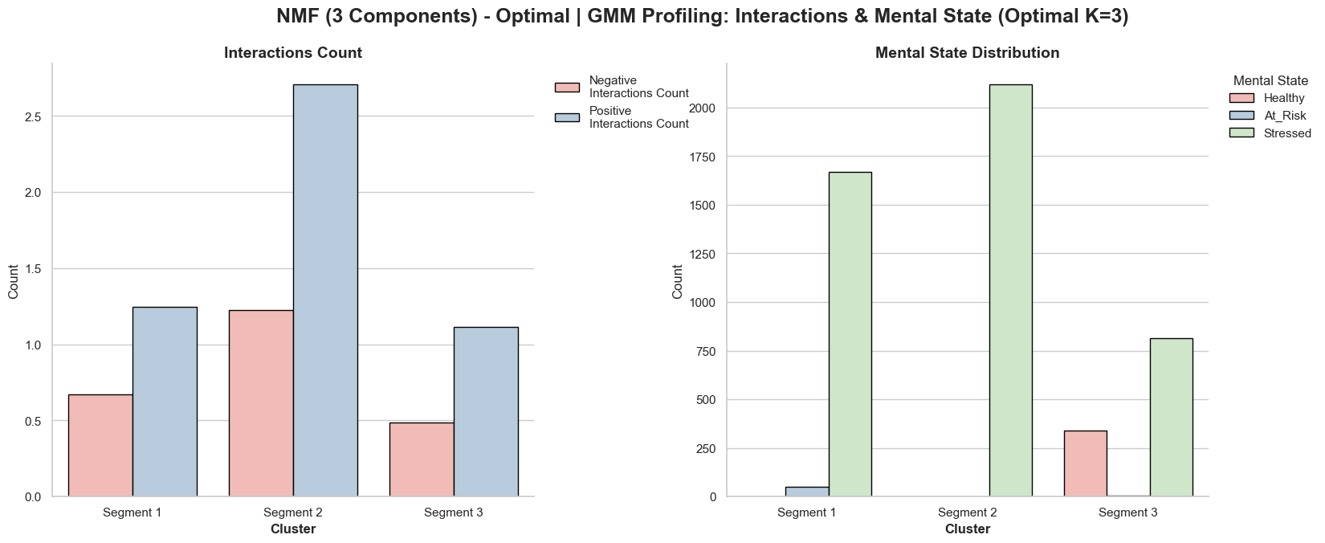
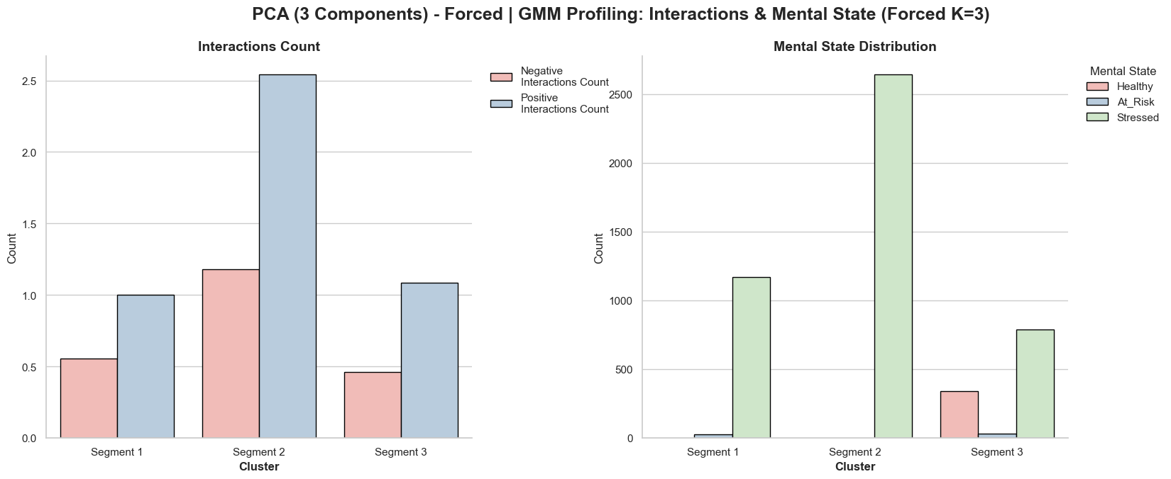
Comparison – PCA and NMF
GMM analyze K = 3
NMF
PCA

Slide 47
Comparison – PCA and NMF
GMM analyze K = 3
NMF
PCA

Slide 48
Comparison – PCA and NMF
conclusions
Consistent Core Clustering
Non-Negativity Advantage
Interpretable Archetypes
Both PCA and NMF produced highly comparable clustering results at K=3, with only minor variations in specific social media platform distributions
We selected NMF for the final analysis because it strictly uses positive values. This perfectly reflects the physical reality of our dataset, where metrics like screen time, age, and interaction counts cannot be negative
By using an additive-only approach, NMF constructs "pure" user profiles rather than abstract mathematical components, making the behavioral segments much easier to interpret and analyze
Notes:
להוסיף מסקנות

Slide 49
PCA
NMF
Variance
7 components
3 components
Choosing
K
NMF – PCA
compare
Final
Synthesis

Slide 50
NMF Cluster Interpretation
Metric | Utility User (cluster 1) | Heavy Social User (cluster 2) | Healthy Low Digital (cluster 3)
Average Age | 25 | 24 | 48
Total Screen Time | 380 minutes | 390 minutes | 210 minutes
Social Media Time | 140 minutes | 240 minutes | 100 minutes
Stress, Anxiety | 6.1, 2.1 | 8.0, 3.1 | 5.1, 1.7
Primary Platforms | WhatsApp, Facebook, Twitter | TikTok, Youtube, Instagram, Snapchat | All platforms

Slide 51
Key conclusion
Screen Time vs. Mental Strain
Age & Platform Preference
There is a distinct, positive correlation between excessive daily screen time and severe psychological strain, specifically driving up anxiety and stress levels
Older demographics experience significantly lower mental strain. This strongly correlates with healthier offline habits, lower overall screen time
Platform Architecture and Mental Strain
Platform design matters just as much as raw screen time
Functional apps, like WhatsApp, correlate with healthier sleep and physical activity routines
Highly visual algorithmic platforms, like TikTok and Instagram, drive stress and anxiety Ultimately, the specific type of digital engagement dictates mental health outcomes
Notes:
להוסיף מסקנות

Slide 52
QUESTIONS?
Notes:
להוסיף מסקנות

